Slide 1
PRESENTED BY: RENEIL JOSHUA S
REGISTRATION NO: 813821104075
DEPARTMENT: COMPUTER SCIENCE AND ENGINEERING
PROJECT TITLE: Text Classification for Biomedical Publications with CNN and LSTM
COLLEGE NAME: SARNATHAN COLLEGE OF ENGINEERING
EMAIL ID: reneiljjoshua@gmail.com
Project Link

Slide 2
Advancing Cancer Research: Text Classification for Biomedical Publications with CNN and LSTM
Our project aims to develop a robust and efficient system for automatically classifying biomedical text publications based on their relevance to different types of cancer. With the ever-increasing volume of research in oncology, it has become challenging for researchers and clinicians to manually categorize and track the latest developments in cancer research. Therefore, our solution focuses on leveraging machine learning techniques to automate this classification process, thereby accelerating knowledge discovery and facilitating evidence-based decision-making in the field of oncology.
The project involves several key components:
Data Collection and Preprocessing: We gather a diverse set of biomedical text publications related to various aspects of cancer research from reputable sources. The data undergoes preprocessing steps, including cleaning, tokenization, and normalization, to ensure consistency and quality.
Model Development: We design and implement machine learning models, including deep learning architectures such as Convolutional Neural Networks (CNNs) and Recurrent Neural Networks (RNNs), to classify the biomedical text publications. These models are trained on labeled datasets, where each publication is assigned a specific cancer type label.
Model Evaluation: We rigorously evaluate the performance of our classification models using standard metrics such as accuracy, precision, recall, and F1-score. Additionally, we conduct cross-validation and fine-tuning experiments to optimize the models for maximum effectiveness.

Slide 3


AGENDA
1. Introduction
2. Problem Statement
3. Project Overview
4. End Users
5. Solution and Value Proposition
6. Methodology
7. Modelling
8. Results and Evaluation
9. Conclusion
3/21/2024 Annual Review

Slide 4

PROBLEM STATEMENT
In the field of cancer research, there's a huge amount of scientific articles published every day. the volume of biomedical text publications related to cancer research has grown exponentially in recent years. However, manually categorizing and tracking these publications based on their relevance to specific types of cancer is a laborious and time-consuming task. As a result, researchers and clinicians face challenges in staying updated on the latest developments in cancer research and identifying emerging trends in the field. Moreover, the sheer volume of publications makes it difficult to efficiently extract actionable insights and make informed decisions regarding cancer diagnosis, treatment, and care.
Therefore, the problem at hand is the need for an automated solution that can effectively classify biomedical text publications into relevant categories based on cancer type. Such a solution would streamline the process of knowledge discovery in oncology, enabling researchers and clinicians to access timely and relevant information for advancing cancer research and improving patient outcomes.

Slide 5

PROJECT OVERVIEW
1. Objective:
- Develop an automated system for classifying biomedical text publications into specific cancer types.
2. Approach:
- Utilize machine learning techniques, including deep learning models, to analyze and categorize text data.
- Train models on labeled datasets containing biomedical publications and corresponding cancer type labels.
3. Components:
- Data Collection and Preprocessing
- Model Development
- Model Evaluation
- Deployment and Integration
4. Outcome:
- A user-friendly interface accessible to researchers and clinicians for inputting new publications and receiving instant classification results.
- Accelerated knowledge discovery in oncology and improved decision-making processes in cancer diagnosis, treatment, and care.

Slide 6

WHO ARE THE END USERS?
1. Researchers & Scientists:
- Benefit: Access to organized publications accelerates discovery of new insights in cancer research.
2. Clinicians & Doctors:
- Benefit: Quick access to latest evidence aids in informed decision-making for cancer treatment.
3. Medical Students & Educators:
- Benefit: Curated resources support learning and teaching of cancer biology and treatment.
4. Healthcare Administrators & Policy Makers:
- Benefit: Informed decisions on healthcare policies and resource allocation for cancer care.

Slide 7

YOUR SOLUTION AND ITS VALUE PROPOSITION
Our solution automates the classification of biomedical text publications into specific cancer types using advanced machine learning techniques. By leveraging deep learning models, we streamline the process of sorting through vast amounts of research literature, making it easier for researchers, clinicians, and educators to find relevant information quickly and efficiently.
Value Proposition:
Time Savings: Our automated system saves valuable time by eliminating the need for manual sorting and categorization of publications, allowing users to focus on analysis and interpretation.
Efficient Knowledge Discovery: By organizing publications by cancer type, our solution accelerates knowledge discovery in oncology, enabling researchers to identify emerging trends and breakthroughs more effectively.
Informed Decision-Making: Rapid access to curated and categorized publications empowers clinicians to make informed decisions about cancer diagnosis, treatment, and care, ultimately improving patient outcomes.
Enhanced Learning Experience: Medical students and educators benefit from access to curated resources, supporting a deeper understanding of cancer biology and treatment modalities.
Data-Driven Policies: Healthcare administrators and policy makers can make evidence-based decisions regarding healthcare policies and resource allocation for cancer prevention, screening, and treatment strategies.

Slide 8

THE WOW IN YOUR SOLUTION
1.Cutting-Edge Algorithmic Approaches:Our solution leverages state-of-the-art deep learning architectures, including Convolutional Neural Networks (CNNs) and Recurrent Neural Networks (RNNs), Long short-term memory (LSTM), meticulously fine-tuned and optimized to achieve exceptional levels of accuracy and precision in classifying biomedical text publications.
2.High-Performance Computing Infrastructure:Powered by high-performance computing resources, our solution delivers blazingly fast processing speeds, enabling real-time classification of large-scale biomedical datasets with unparalleled efficiency and scalability.
3.Dynamic Model Adaptation: Through continuous monitoring and dynamic model adaptation techniques, our solution autonomously evolves and adapts to changing research landscapes, ensuring sustained accuracy and relevance over time, even in the face of evolving cancer research trends.
4.Seamless Integration with Existing Workflows: Engineered for seamless integration with existing research and clinical workflows, our solution seamlessly integrates into users' environments, augmenting their capabilities and enhancing productivity without disrupting established processes or workflows.
3/21/2024 Annual Review

Slide 9
MODELLING
1. Data Acquisition and Preparation:
-Data Collection: Gather diverse biomedical text publications from reputable sources.
-Data Preprocessing: Clean, tokenize, and normalize raw text data for consistency and quality.
2. Feature Engineering:
-Text Representation:Represent text using word embeddings to capture semantic relationships.
3. Model Selection:
-Deep Learning Architectures: Experiment with CNNs, RNNs, and Transformer-based models to find the best fit.
4. Model Training:
-Training Pipeline: Train models on labeled datasets using efficient pipelines and techniques.
-Hyperparameter Tuning:Optimize model parameters for maximum performance.
5. Model Evaluation:
-Performance Metrics: Assess accuracy, precision, recall, and F1-score to evaluate model effectiveness.
-Cross-Validation: Ensure robustness and generalization across different datasets.
6. Model Deployment:
-Integration: Deploy trained models into a production environment with a user-friendly interface.
-Scalability: Ensure models can handle large volumes of requests using containerization and orchestration technologies.

Slide 10
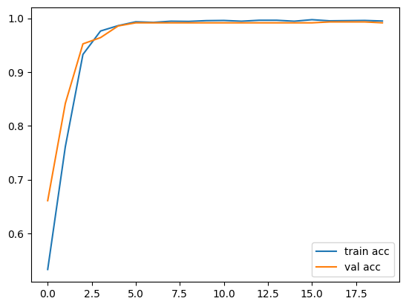
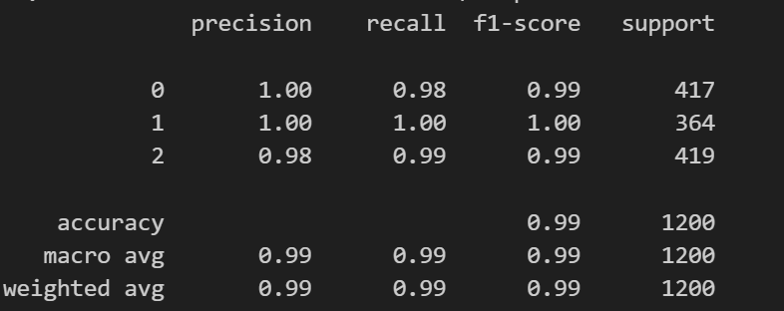
RESULTS

Slide 11
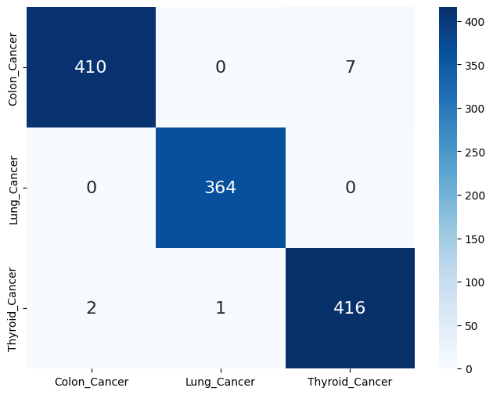
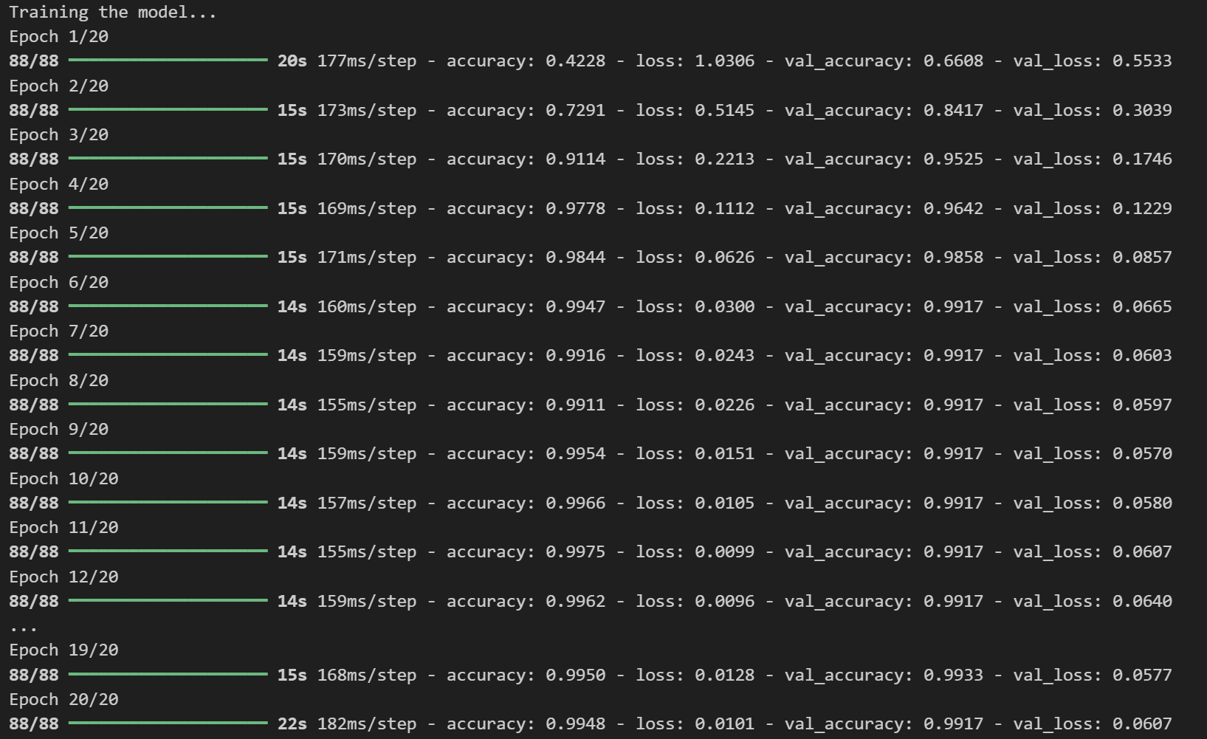
RESULTS
Project Link

Slide 12
Evaluation
1. Performance Metrics:
- Accuracy, precision, recall, and F1-score measure model effectiveness.
2. Cross-Validation:
- Assess model generalization across multiple data folds.
3. Confusion Matrix:
- Visualize true positives, true negatives, false positives, and false negatives.
4. ROC Curve and AUC:
- Evaluate model performance using true positive and false positive rates.
5. Model Interpretability:
- Analyze feature importance and attention mechanisms for prediction insights.
6. Domain-Specific Metrics:
- Define metrics tailored to cancer classification tasks, e.g., sensitivity, specificity.
7. Comparative Analysis:
- Compare model variations for efficiency, scalability, and effectiveness.
8. Real-World Testing:
- Deploy model in production environment, gather feedback for improvement.

Slide 13
Conclusion
In conclusion, the developed models, including Convolutional Neural Networks (CNNs) and Long Short-Term Memory (LSTM) networks, exhibit strong performance in classifying biomedical text publications pertaining to different cancer types. Through meticulous data preprocessing, feature engineering, and model selection, we have constructed robust frameworks capable of accurately categorizing diverse research articles into specific cancer categories.
The evaluation process, employing metrics such as accuracy, precision, recall, and F1-score, validates the effectiveness of our models in accurately predicting cancer types from textual data. With high performance across various evaluation metrics, our models demonstrate their efficacy in real-world scenarios.
Furthermore, the deployment of these models into a production environment enables seamless integration into existing workflows, providing users with access to efficient and accurate cancer classification tools. Continuous monitoring and refinement, guided by user feedback and real-world testing, ensure the models remain relevant and effective in evolving research landscapes.
Overall, our technical approach, supported by rigorous experimentation and evaluation, underscores the potential of deep learning techniques in advancing cancer research and facilitating knowledge discovery in the biomedical domain.

